Slide 1
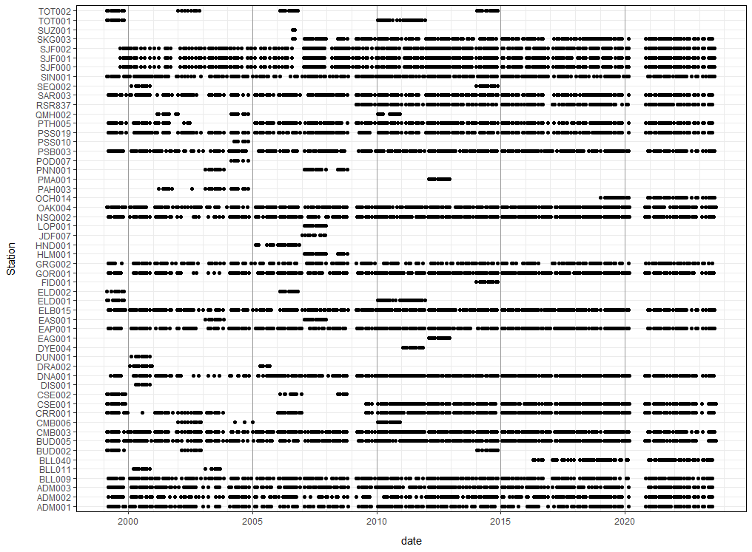
NO3
NO2
NH4
Transmission_25cm
Beam attenuation
Fluorescence
Turbidity
DO
Salinity
Conductivity
Temperature

Slide 2

NO3
NO2
NH4
Transmission_25cm
Beam attenuation
Fluorescence
Turbidity
DO
Salinity
Conductivity
Temperature

Slide 3

NO3
NO2
NH4
Transmission_25cm
Beam attenuation
Fluorescence
Turbidity
DO
Salinity
Conductivity
Temperature

Slide 4
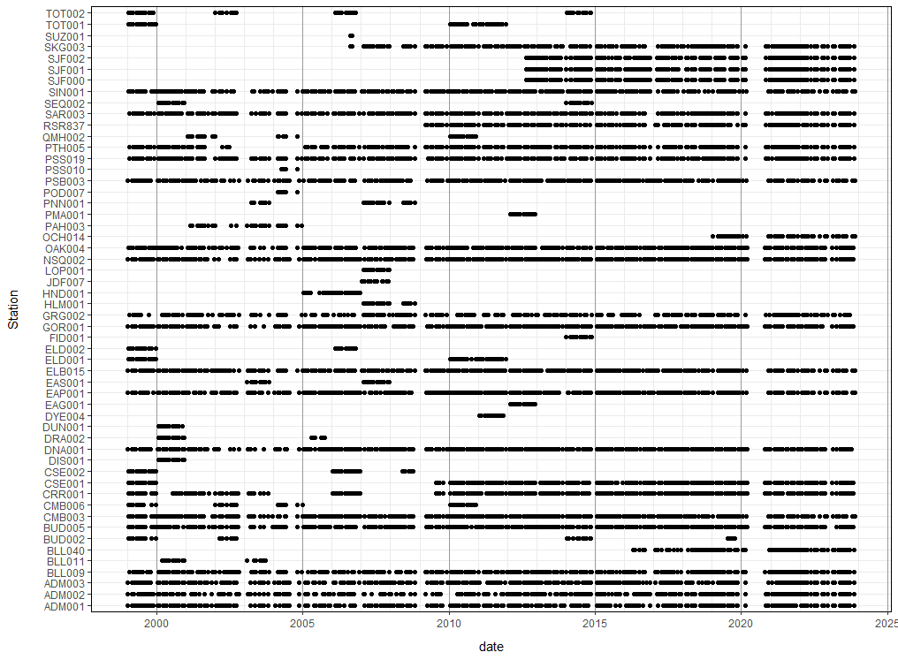
NO3
NO2
NH4
Transmission_25cm
Beam attenuation
Fluorescence
Turbidity
DO
Salinity
Conductivity
Temperature

Slide 5

NO3
NO2
NH4
Transmission_25cm
Beam attenuation
Fluorescence
Turbidity
DO
Salinity
Conductivity
Temperature

Slide 6
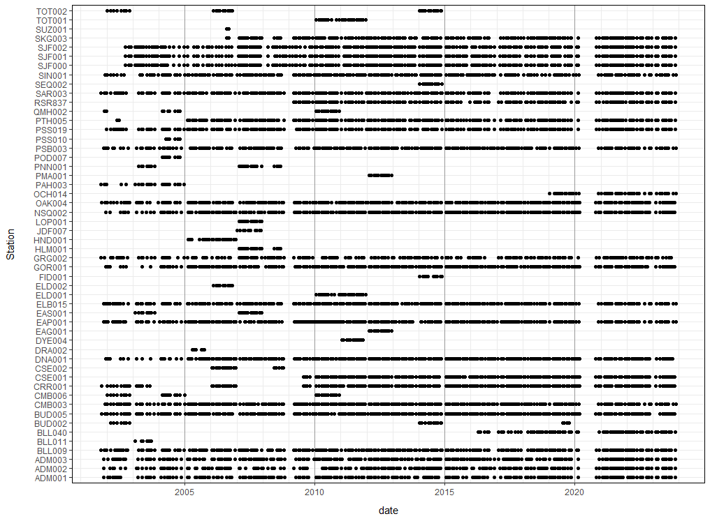
NO3
NO2
NH4
Transmission_25cm
Beam attenuation
Fluorescence
Turbidity
DO
Salinity
Conductivity
Temperature

Slide 7
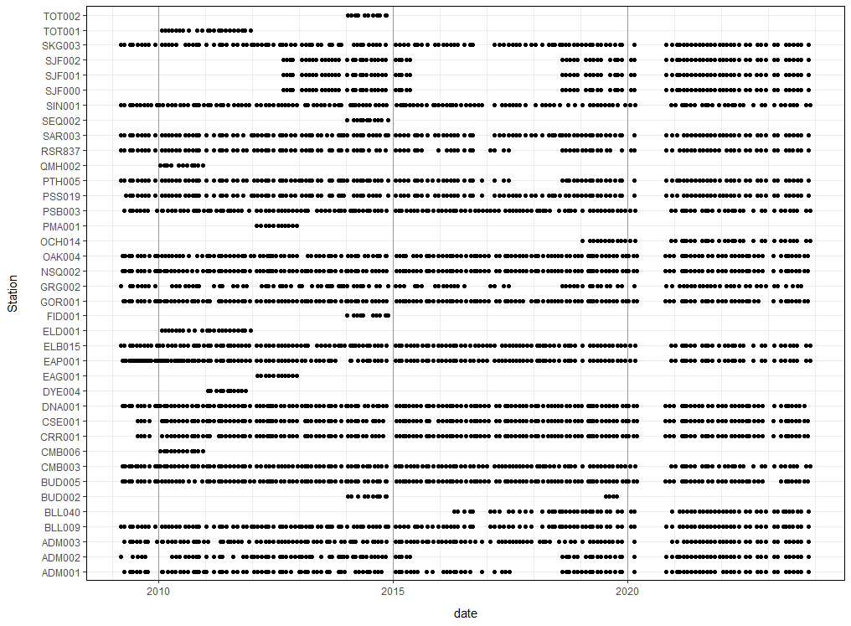
NO3
NO2
NH4
Transmission_25cm
Beam attenuation
Fluorescence
Turbidity
DO
Salinity
Conductivity
Temperature

Slide 8
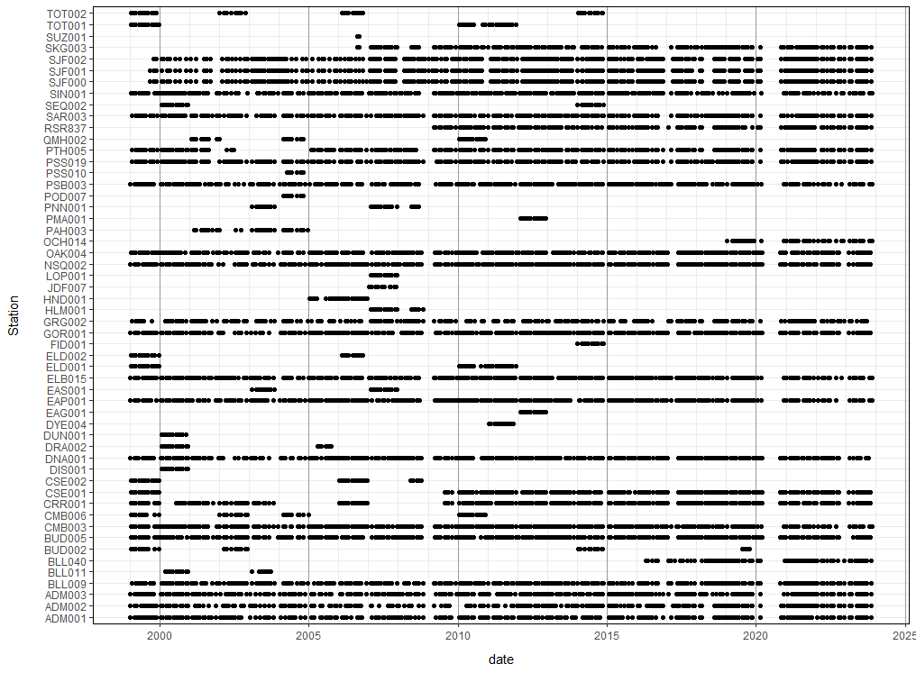
NO3
NO2
NH4
Transmission_25cm
Beam attenuation
Fluorescence
Turbidity
DO
Salinity
Conductivity
Temperature

Slide 9

NO3
NO2
NH4
Transmission_25cm
Beam attenuation
Fluorescence
Turbidity
DO
Salinity
Conductivity
Temperature

Slide 10
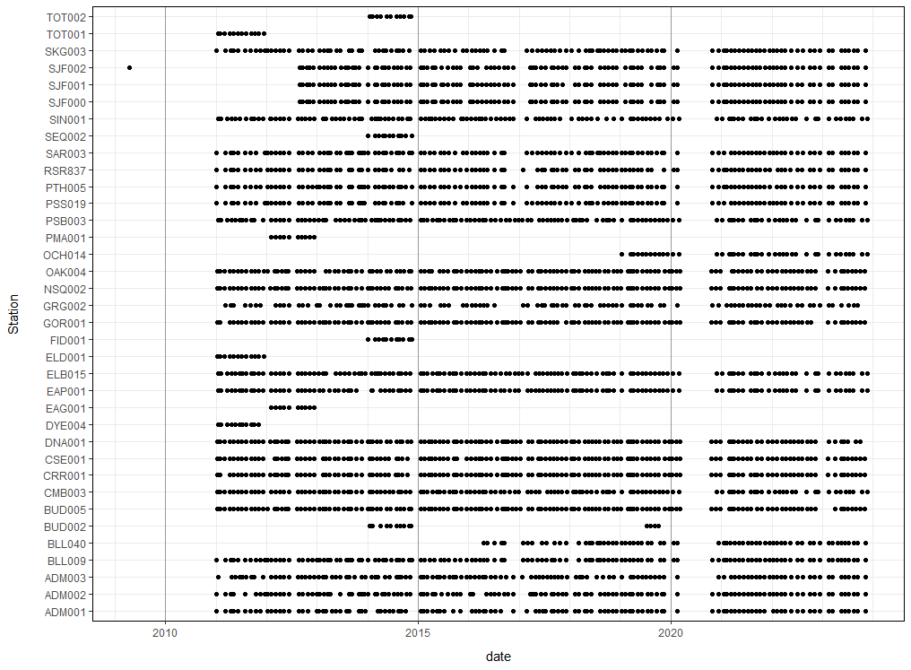
NO3
NO2
NH4
Transmission_25cm
Beam attenuation
Fluorescence
Turbidity
DO
Salinity
Conductivity
Temperature

Slide 11

NO3
NO2
NH4
Transmission_25cm
Beam attenuation
Fluorescence
Turbidity
DO
Salinity
Conductivity
Temperature

Slide 12
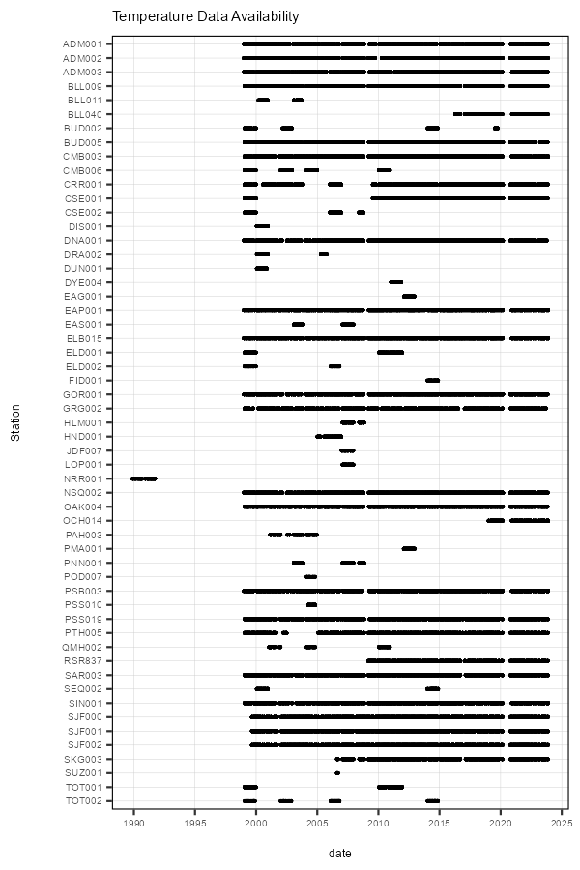
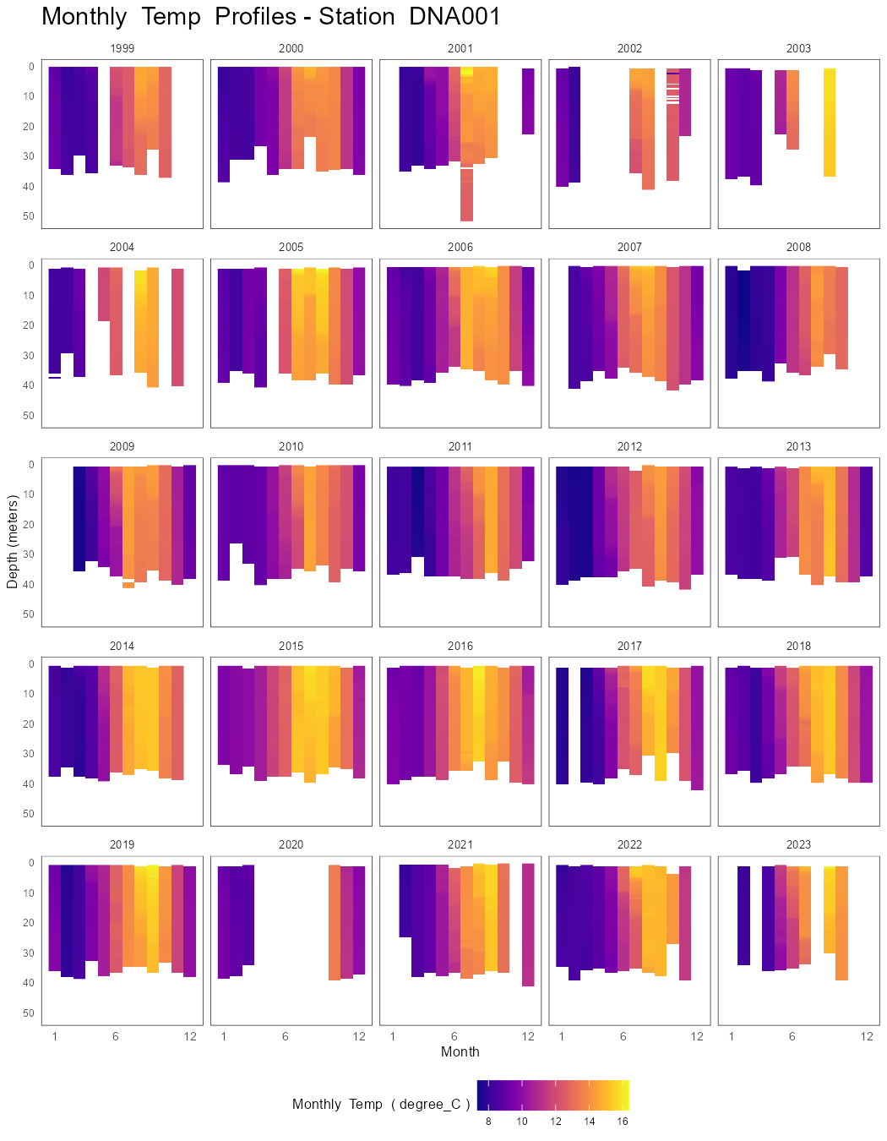
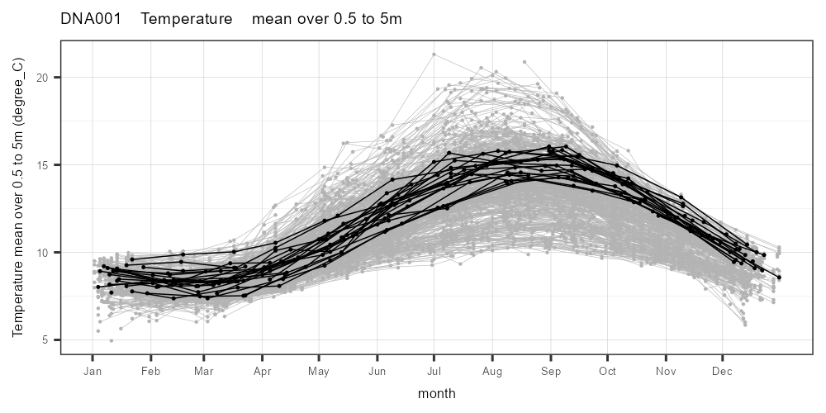
inputs
definitions.r
netCDF files
Data flow and R scripts
var_table
b_compile_annual_netCDF.r
ecy_prof_tbl 9350 x 4
ecy_meas_qa 1218649 x 33
ecy_stn_tbl 76 x 4
varList
qaList
NRR001_0_discrete.csv
NRR001_0_profile_download.csv
calendar_graph.r
HSIL study area filter (n=55)
QA & missing handling
get_NRR_data.r
GIS
color_profile_histo_by_depth.r
ecy_stn_tbl 77 x 4
ecy_meas_qa 1219640 x 33
resolve multi-profile months
HSIL study area filter
data freq. by depth
histograms
ecy_stations_subgroups_tbl.csv
f_seasonal_graphs_data_prep.r
make_stn_var_tbl.r
data count filter, unused (n>=1)
QA=2 filter & HSIL study area filter
3 profile reduction methods
ecy_stn_var_tbl.csv
ecy_var_graphing
loop through
variables with index
var_index
g_seasonal_graphs.r
e_add_date_count_to_station_file.r
HSIL study area filter
station_cnt 77 x 7
ecy_stations_subgroupgs_cnt_tbl.csv
station_floating_bar_line_ups.r
make_stn_var_tbl.r
stn freq. by data count histogram
stn_var_tbl_jn.csv
stn_var_tbl_jn

Slide 13
station_floating_bar_line_ups.r

Slide 14
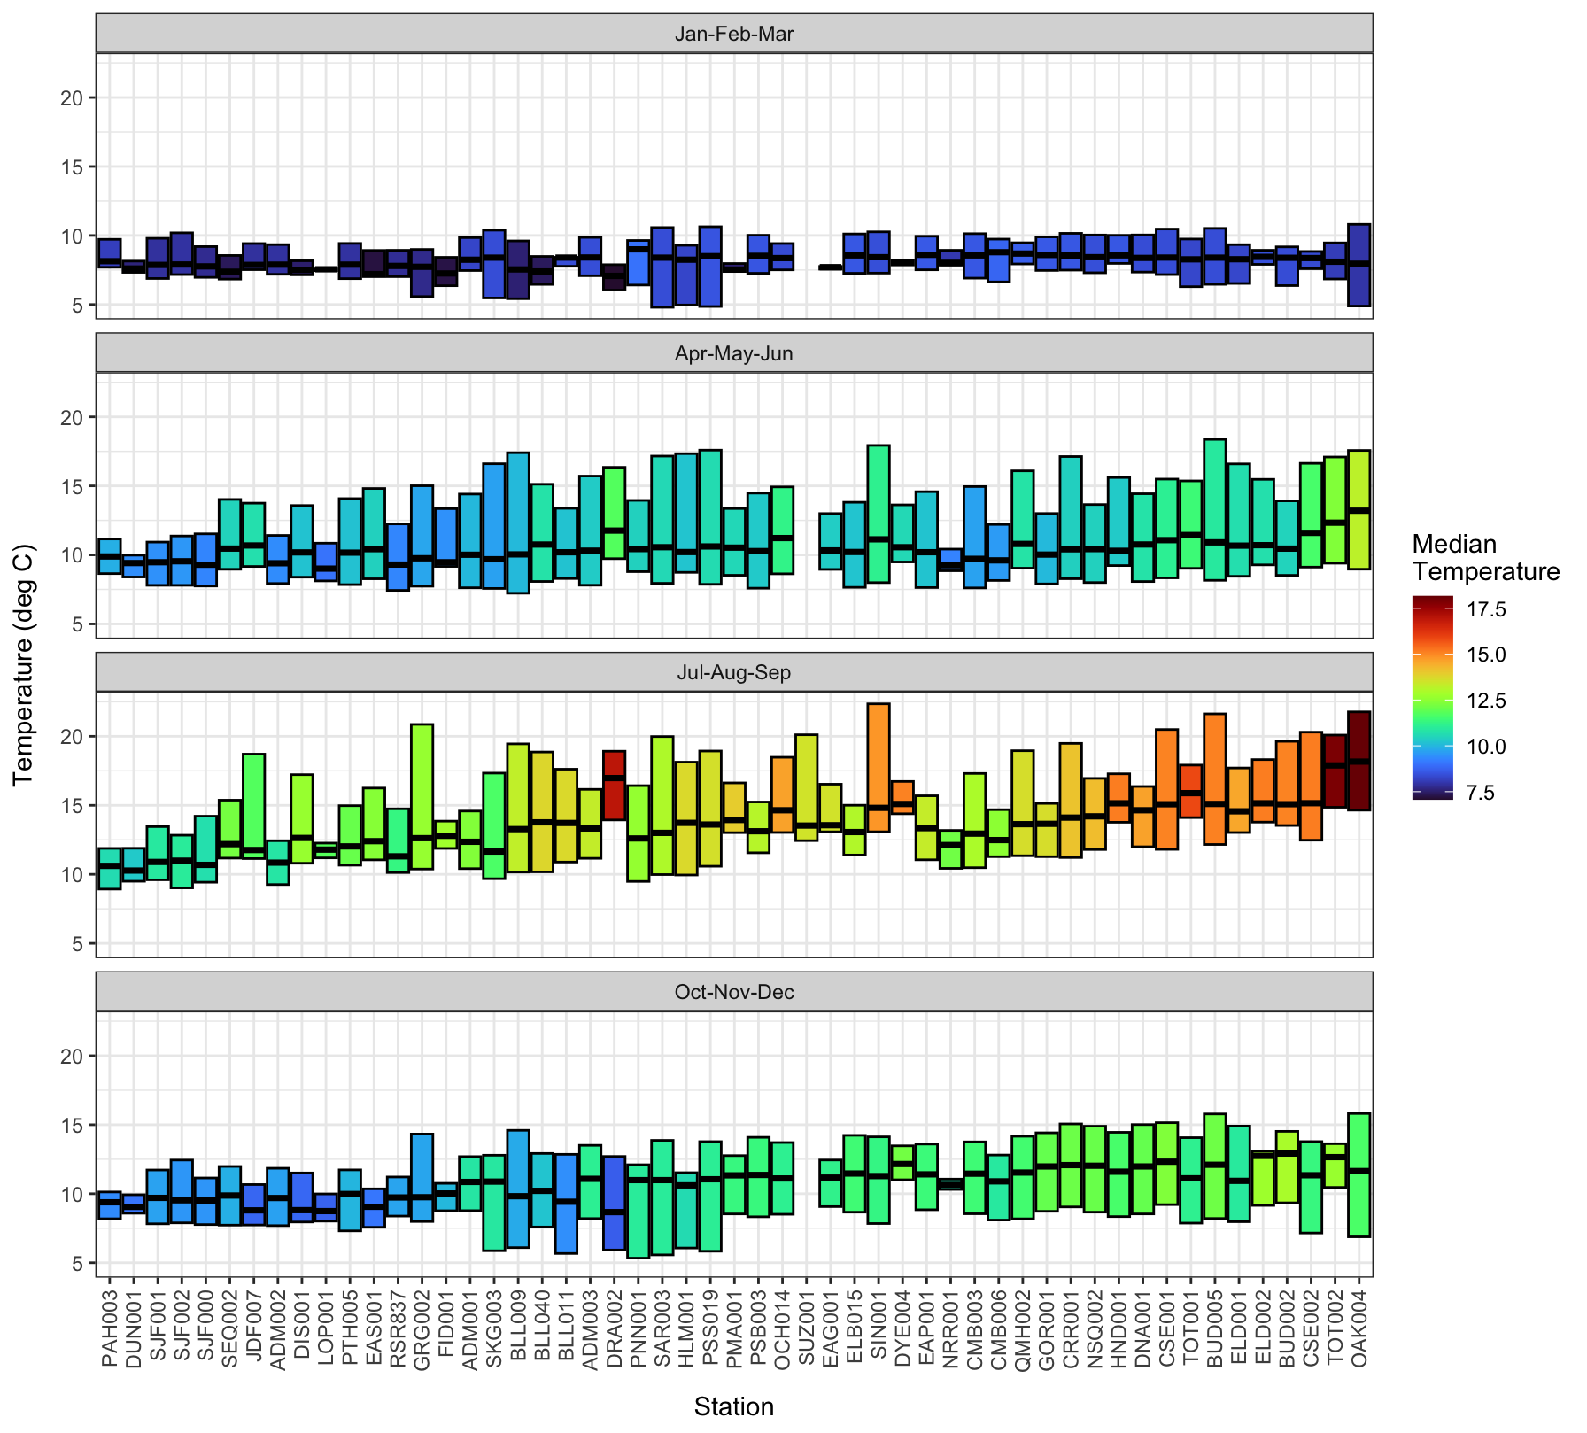
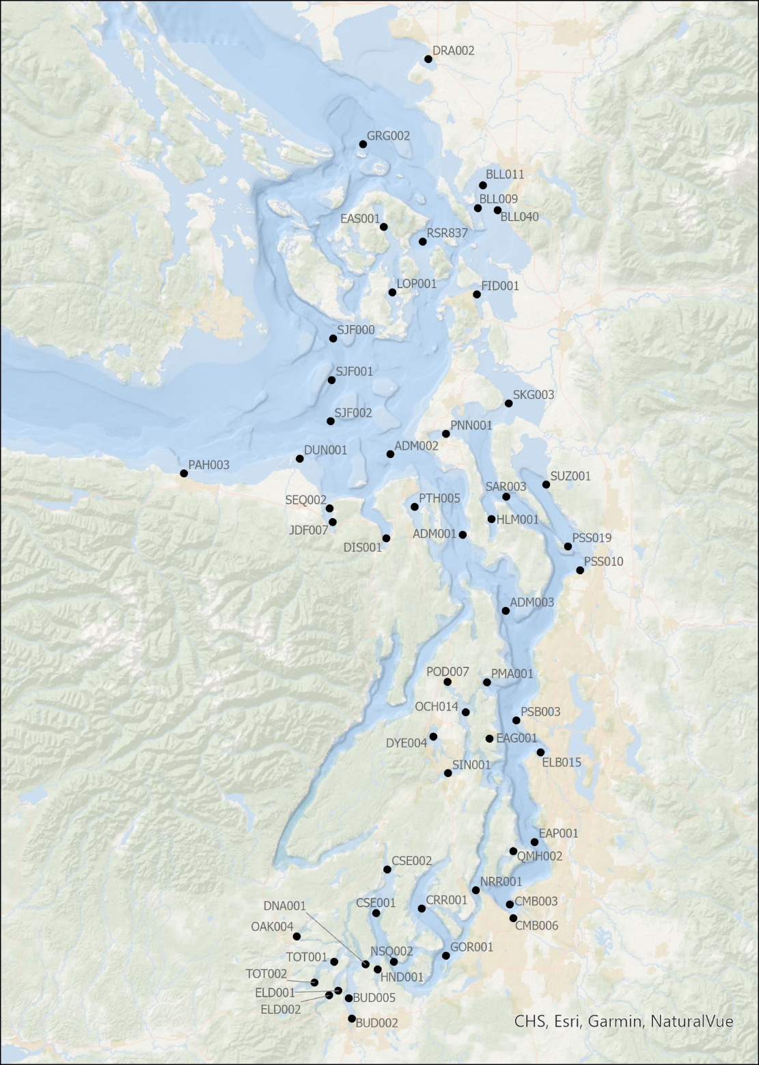

Slide 16
role of precision: we don’t know how the variation in time (annual variation + sampling error instances) compares to the station-to-station variability. relevant to this project that needs to put one year of samping into a broader context.
seasonal graphs
high temp site & low temp site (red and blue) with map
Use summary stats for quarters - need to filter out low n stations
residual distribution somewhat normal - smaller n acceptable (state station counts for temp: original, after 10 filter, after 8 filter, 5 filter) - prioritizing data inclusion to prioritizing robust estimates.
floating bars. For temp (modify as needed for salinity, NO3, trans+):
a trend in temp with distance from ocean
the relative magnitudes of the variations
stations with strong deviation from the trend line: map deviation with trend shown as
fill color with gradient in fill color scaled to distance from ocean.
fill color only neutral, warmer, cooler as bubbles with bubble size showing magnitude of deviation from trend line.

Slide 17
Station-season floating bars.
Temperature station counts under different min. sample date filters
total N = 55 stations
sample size >=5; 37 stations
sample size >=8; 30 stations
sample size >= 10; 26 stations

Slide 18
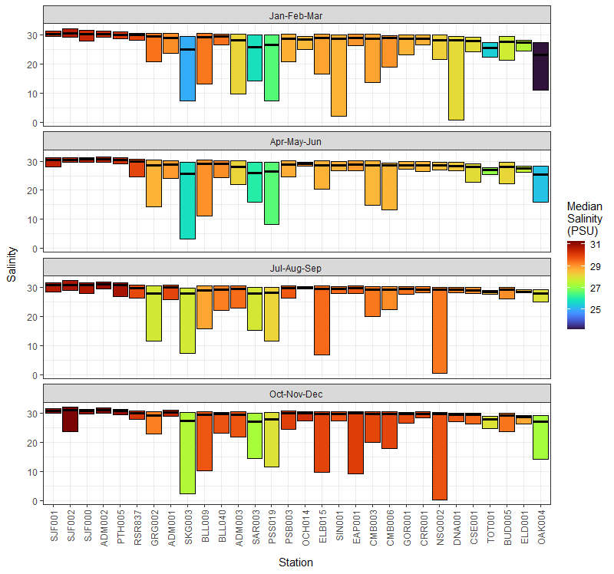
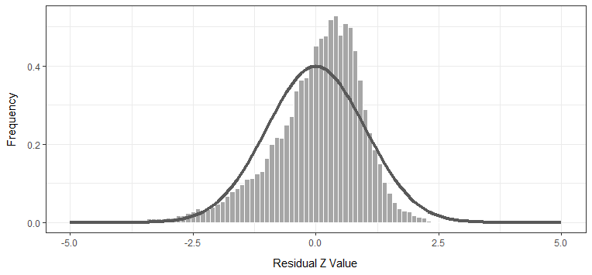
Salinity 0-10m

Slide 19
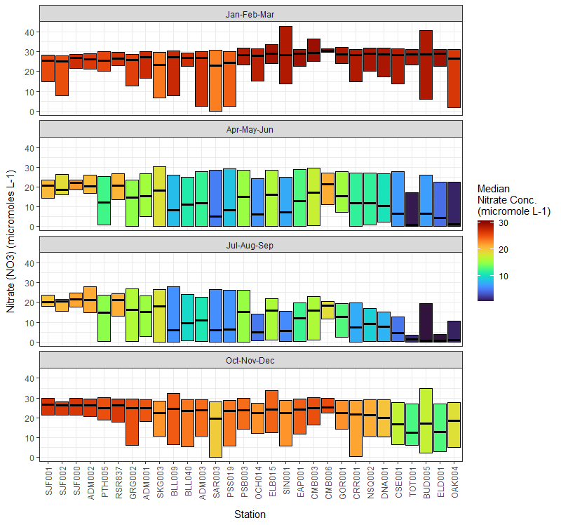
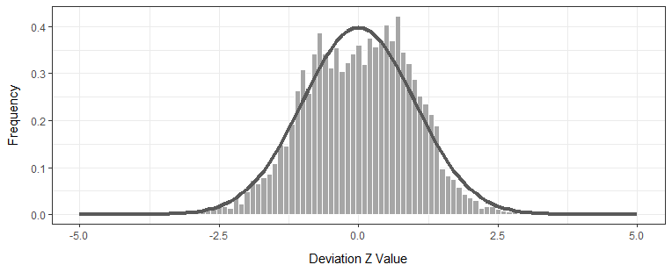
Nitrate 0-10m

Slide 20
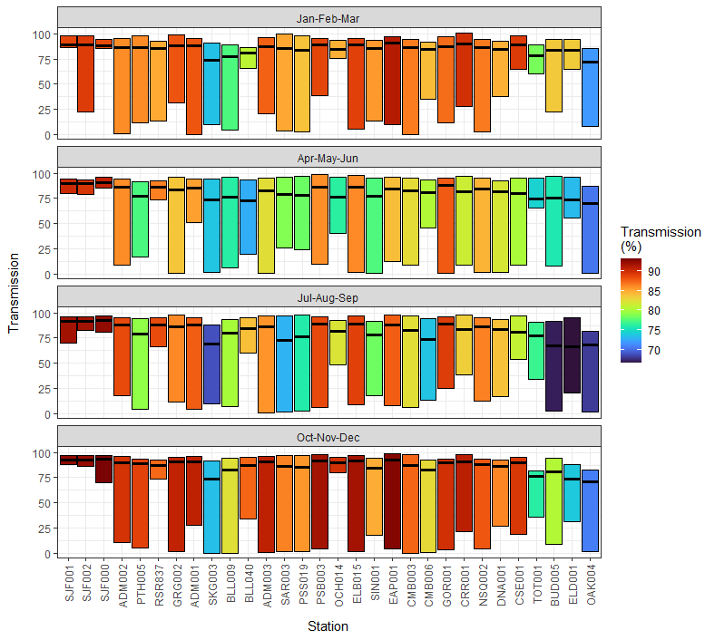
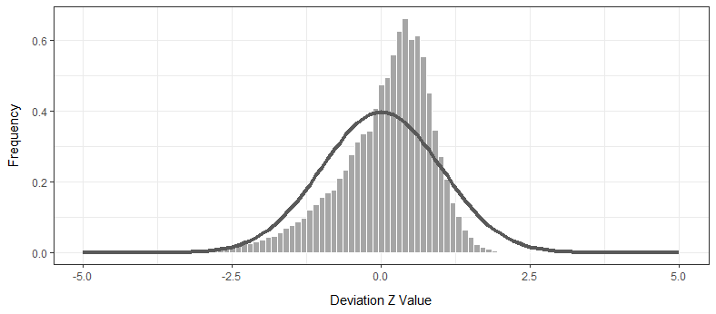
Transmission 0-10m

Slide 21
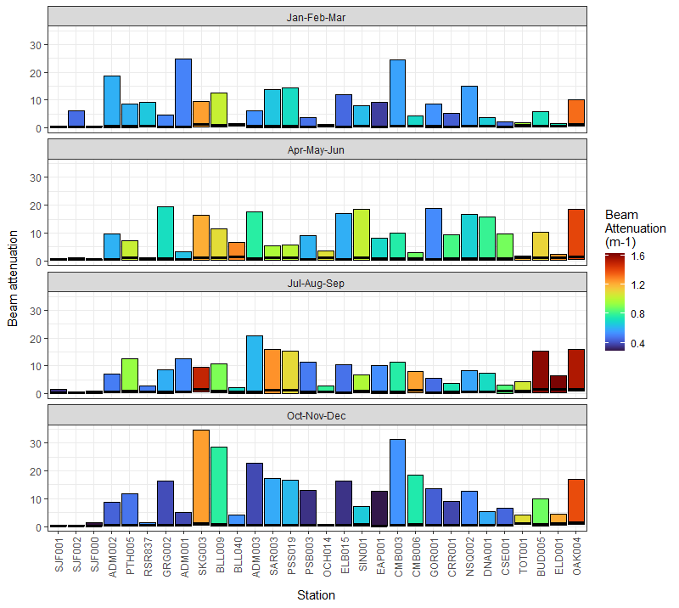
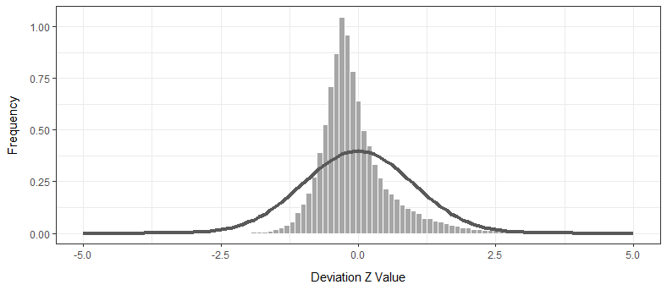
Beam Attenuation 0-10m

Slide 22
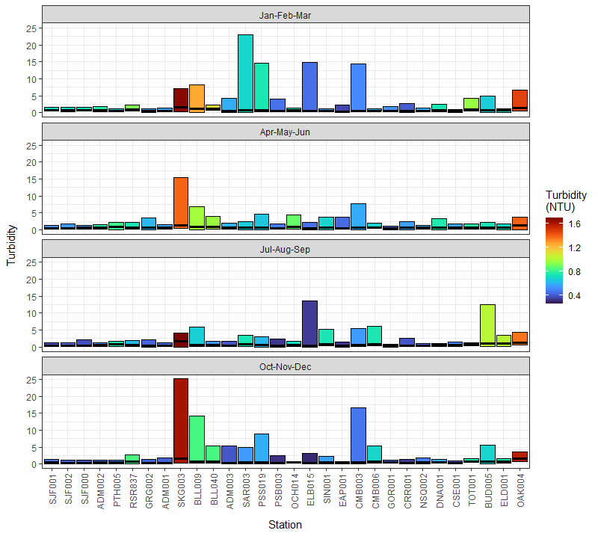
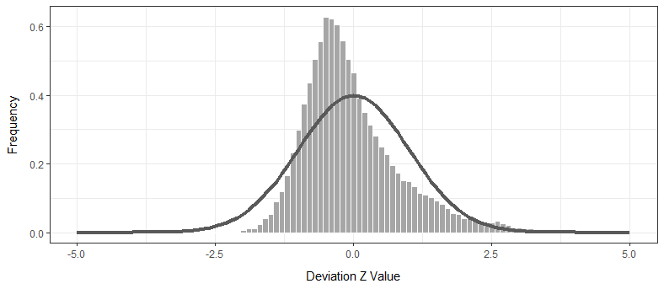
Turbidity 0-10m

Slide 23
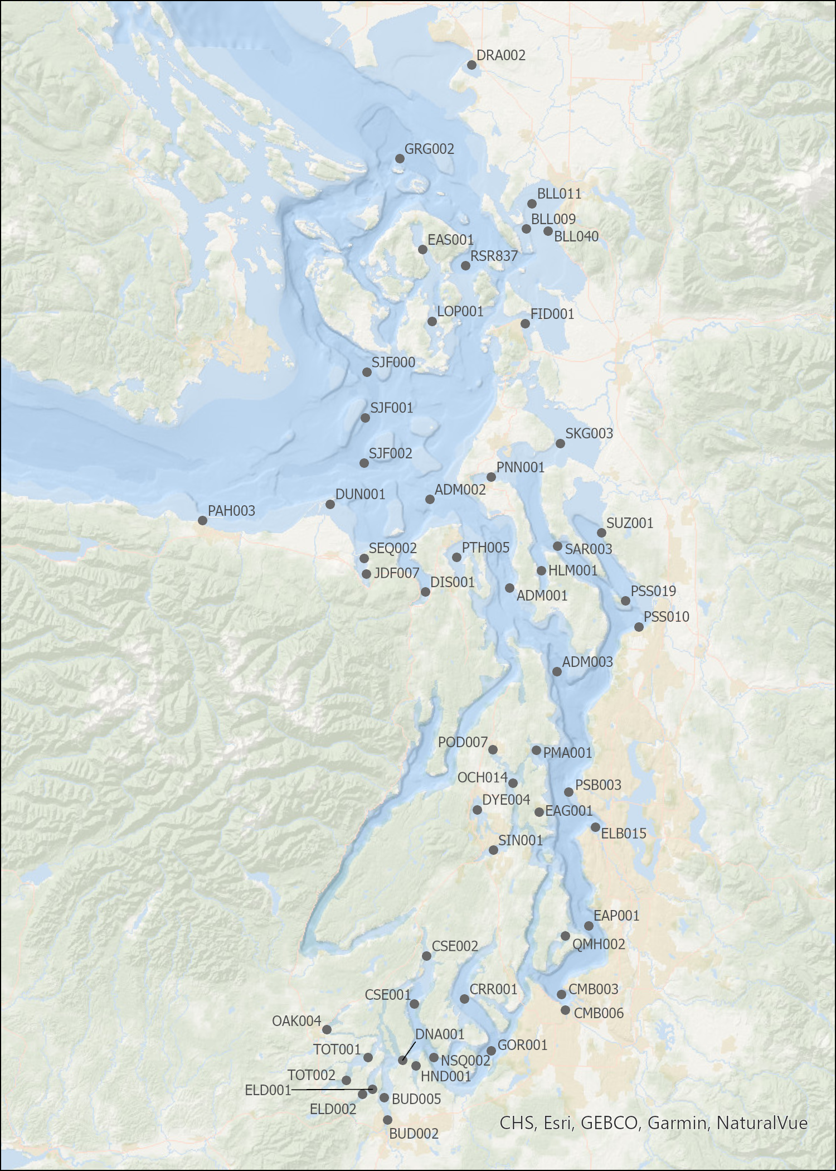

Slide 24
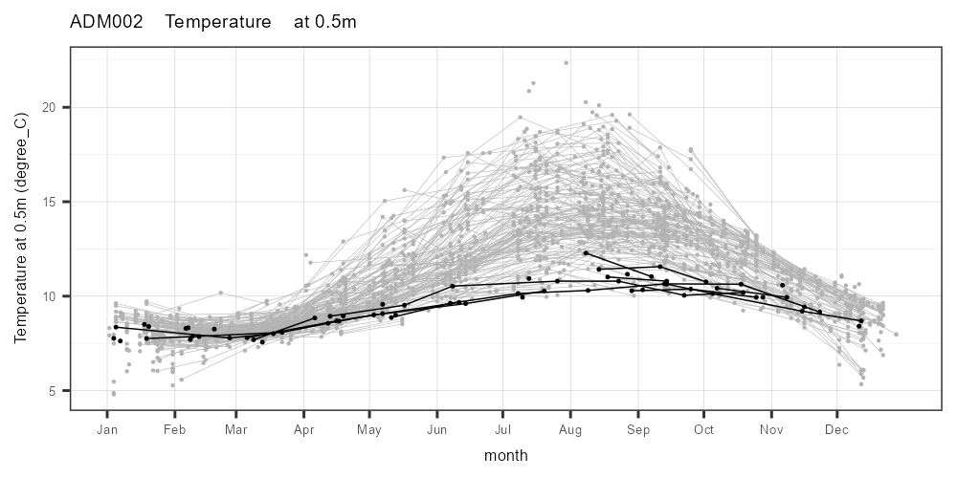
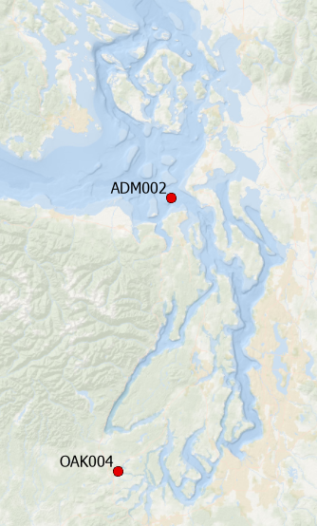
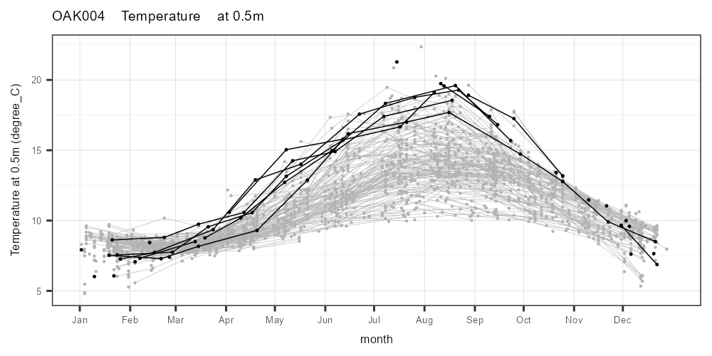

Slide 25
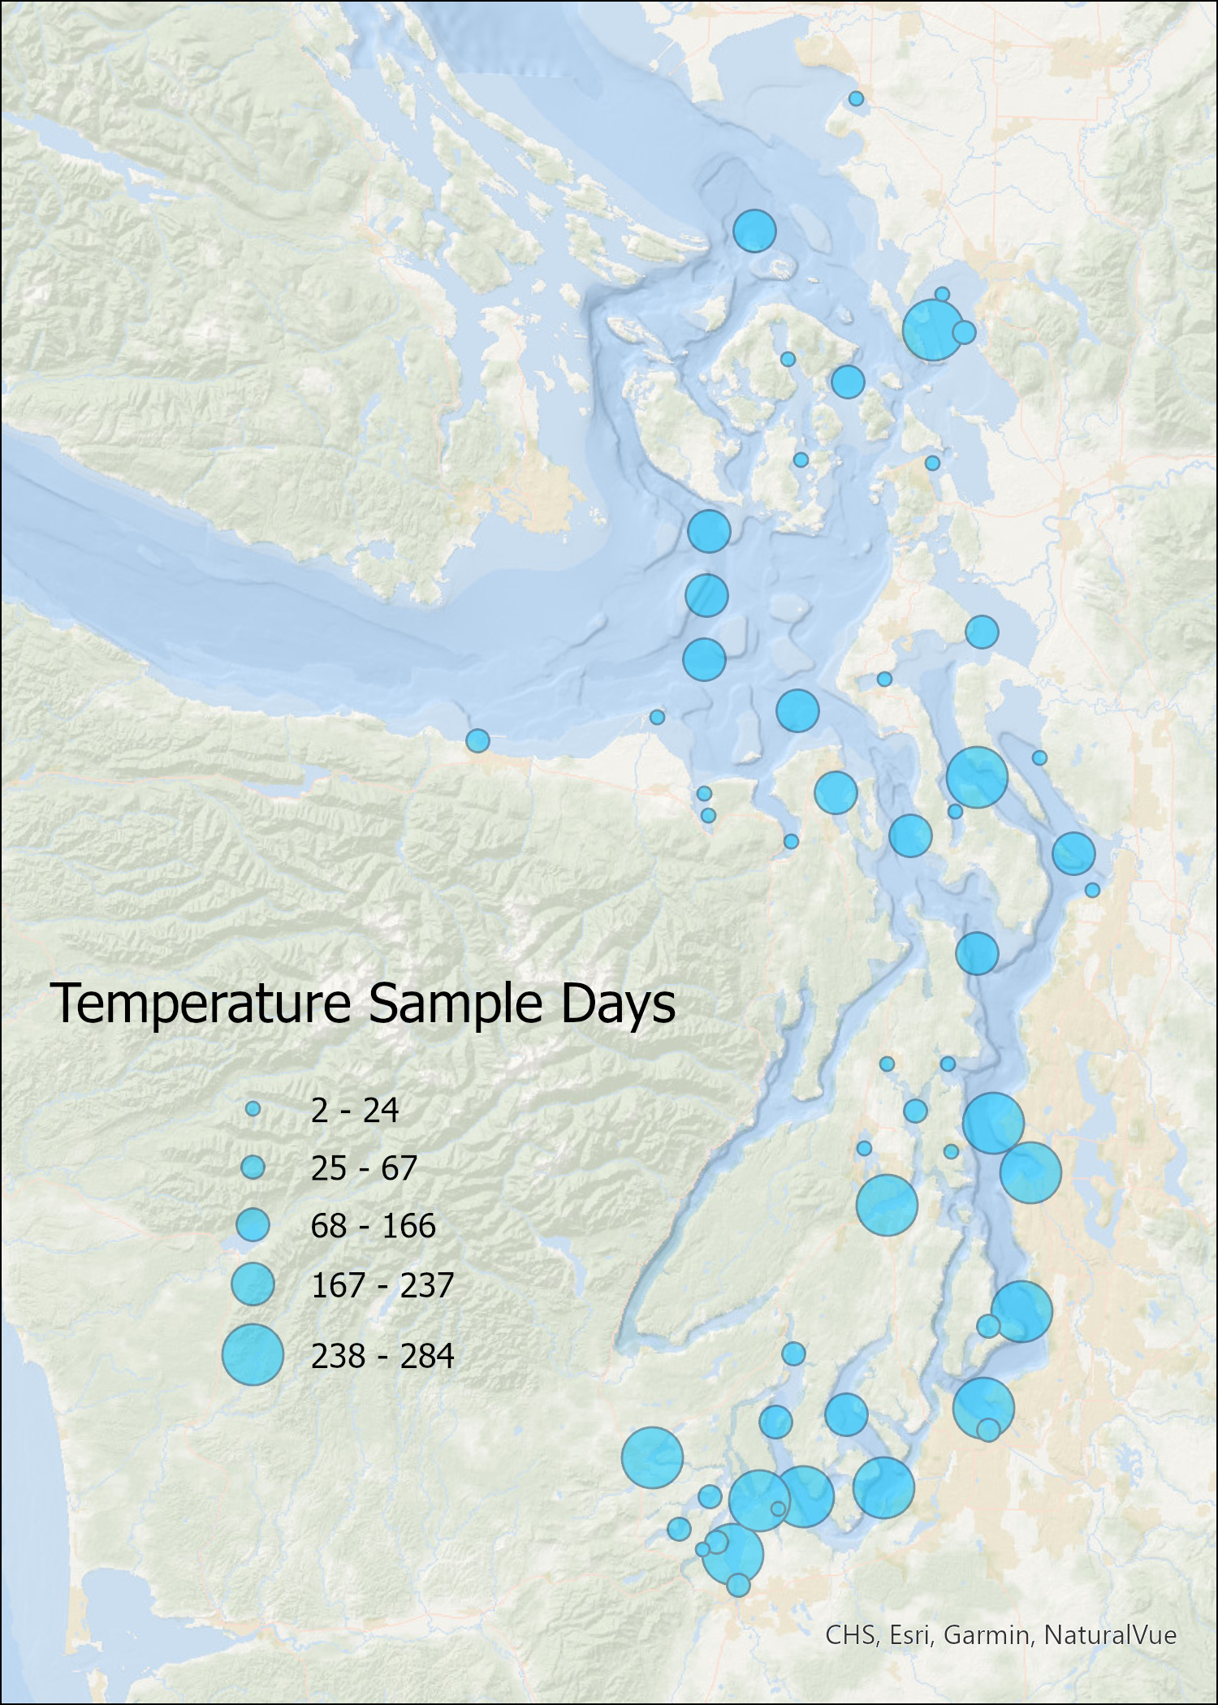
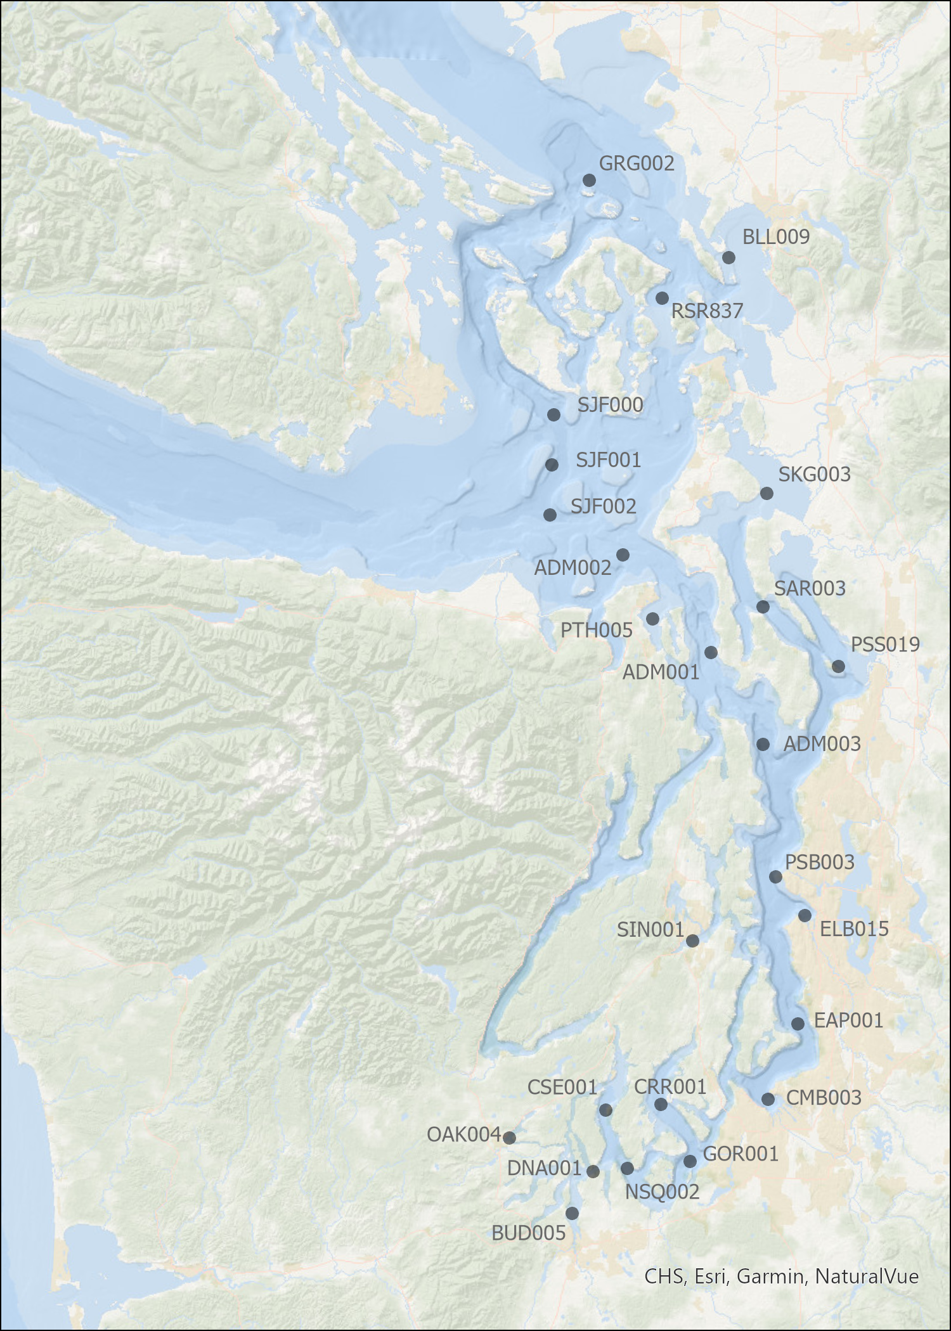
Filtered for sites with >100 sample days

Slide 26
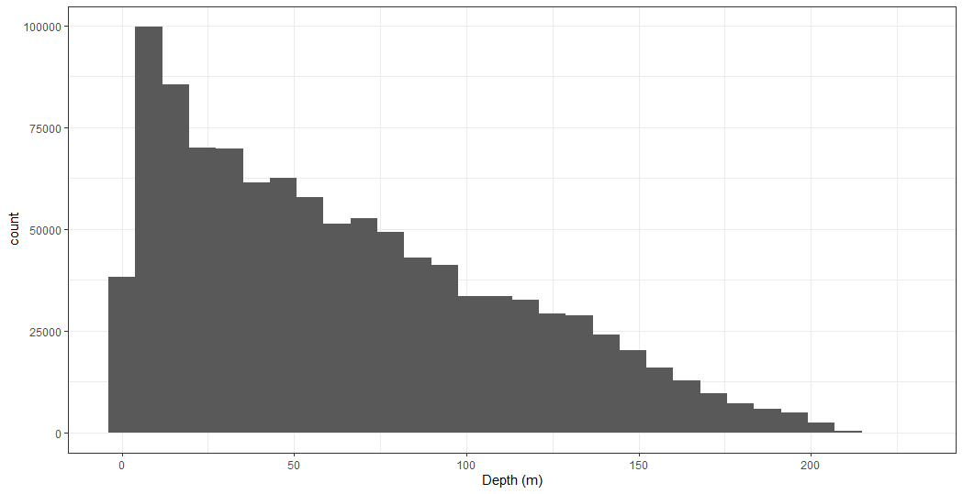
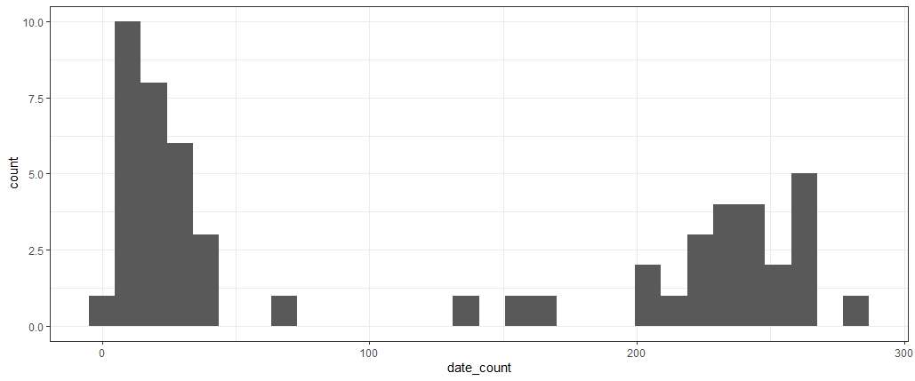
Overall Temp data frequency by depth
Shallowest obs = 0.5 m depth
Station frequency by date count

Slide 27
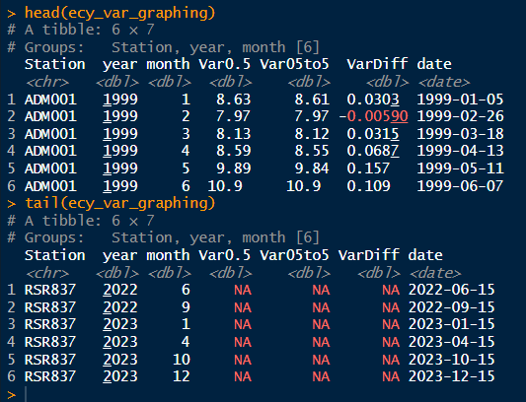
Created table for seasonal graphing
Consolidated netCDF files
Extract single variable of interest (e.g. temp, salinity, transmissivity, NO3)
Select sites in HSIL study area (drop outer coast and Hood Canal sites)
Summarize profiles in 3 different ways: 0.5m value; 0.5 to 5m average; 0.5 – 5m difference
Add NA records for missing months within the record begin/end for each site
Resulting table for graphing
Need spot checks to confirm NA values for profile summary variables.
Confirmed RSR837 values of NA shown are correct.

Slide 28
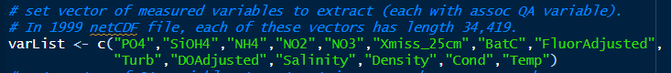
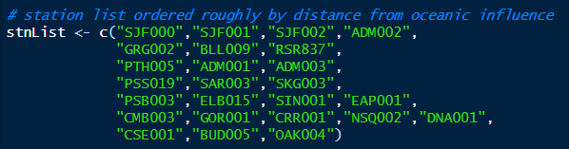
Data Calendar
Color-ramp Profiles
Seasonal curves
By variable
By variable, by station
By variable, by station
variables
Depth summary
Variable dependent
Discrete:
Top depth (above 2m)
Bottom depth (below 2m)
Continuous:
0.5 m
0.5 to 5 m average
0.5 & 5 m difference
Calendar by variable with map link on selected site
Color-ramp profiles by selected variable and selected site
Seasonal curves
14 variables x 3 depth summaries x 25 sites x 2 graph types

Slide 29
Data Calendar
Color-ramp Profiles
Seasonal curves
By variable
By variable, by station
By variable, by station
By profile reduction method
M a p
M a p
stations (76 pt features)
station_name
M a p
stations (76 pt features)
station_name
stations (76 pt features)
station_name
Map has search box for station name with auto complete
Map has scale-sensitive labelling so labels only appear when zoomed in enough to have sufficient spacing.
stations (350 pt features)
station_name (n = 25)
Variable (n = 14)
profileURL
stations (1050 table rows)
station_name (n = 25)
Variable (n = 14)
seasonalURL
prof. reduction (n = 3)
calendarURLs (14 table rows)
variable (n = 14)
calendarURL
Filter: variable
Filter: variable
Filter: variable
Filter from map selection: station
Filter from map selection: station
Filter: profile reduction method
calendar image
(for filtered variable)
profile image
(for filtered variable, station)
seasonal image
(for filtered var, stn, prof. reduction)

Slide 30
Data Calendar
Color-ramp Profiles
Seasonal curves
By variable
By variable, by station
14 x 25 = 350
By variable, by station
By profile reduction method
Variable pulldown
Station map
Variable calendar
Station table
Station_name
Station table
Station_name – variable - calendarURL

